Slide 1
The Solar System
Allison Pramberger
EDU 521.03
Prof. R. Moroney
Summer 2010

Slide 2
Title Page created on the “Wordle”
Website and then a screen shot
(print screen command and “c”
for copy) was used to place
the image on the title slide.

Slide 3
Introduction
In this unit intended for a 3rd grade class students will learn the basic concepts of the Solar System. This will include a focus on our planet, Earth, the sun, and the seven other planets that orbit around it. Students will come to a better understanding of why life as we know it exists only on Earth and the characteristics held by the other planets that also orbit the central point of our solar system, the sun. This unit will allow to students to broaden their knowledge of the universe and allow them a glimpse into the fascinating and mysterious concepts of the solar system.

Slide 4
The Context of My Project
The students would be the active participants in this unit.
This unit is intended to be used as a 3rd Grade Science Lesson
There are 20 students in the class
The students have had guided instruction with technology throughout the year
The children have access to a few computers in the classroom as well as a computer lab that the teacher schedules class time in.
For lessons that include utilizing technology there will be a computer teacher also available for assistance
The first detailed lesson would be the introduction to the unit, while the second lesson would be found near the end of the unit before the final project.

Slide 5
Aim of the Project
My objective for the students would be for them to understand the rather abstract concepts of the solar system, including where each planet goes in its rotation around the sun and what it is like on each planet with a specific focus on the earth.
They will demonstrate this knowledge using a variety of resources which include internet hotlists, video clips, podcasts, virtual field trips, and writing activities.

Slide 6
Justification
I am using technology to meet these goals in order to provide the students with a variety of resources to learn from in order to differentiate the instruction of this unit.
Technology supports my curriculum by helping students to stay actively engaged in the lessons and provides a more hands on learning approach where they have more ownership over the lessons at hand.

Slide 7
Materials
Computers with internet access · Projector and Screen · Audio Podcast · Hangers · Templates for the planets and sun · String · Crayons · Printer · Bar Graph Worksheet · Pencils

Slide 8
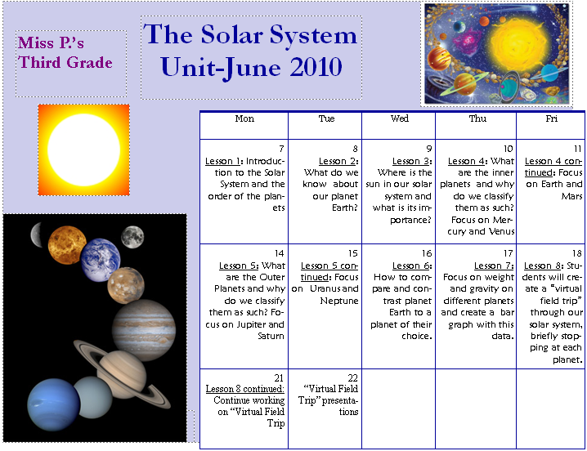
Time Frame

Slide 9
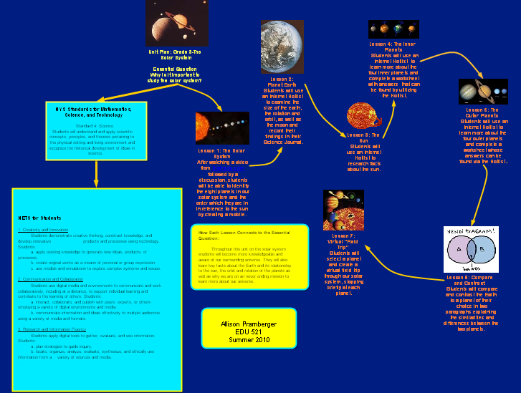
Graphic Organizer Project

Slide 10
All NYS and ISTE Learning Standards covered within the unit
1. Creativity and Innovation Students demonstrate creative thinking, construct knowledge, and develop innovative products and processes using technology. Students: a. apply existing knowledge to generate new ideas, products, or processes. b. create original works as a means of personal or group expression. c. use models and simulations to explore complex systems and issues. 2. Communication and Collaboration Students use digital media and environments to communicate and work collaboratively, including at a distance, to support individual learning and contribute to the learning of others. Students: a. interact, collaborate, and publish with peers, experts, or others employing a variety of digital environments and media. b. communicate information and ideas effectively to multiple audiences using a variety of media and formats. . 3. Research and Information Fluency Students apply digital tools to gather, evaluate, and use information. Students: a. plan strategies to guide inquiry. b. locate, organize, analyze, evaluate, synthesize, and ethically use information from a variety of sources and media.

Slide 11
Standards cont.
Mathematics, Science, and Technology Standard 4: Science Students will understand and apply scientific concepts, principles, and theories pertaining to the physical setting and living environment and recognize the historical development of ideas in science. Standard 5: Technology Students will apply technological knowledge and skills to design, construct, use, and evaluate products and systems to satisfy human and environmental needs. The Arts Standard 2: Knowing and Using Arts Materials and Resources Students will be knowledgeable about and make use of the materials and resources available for participation in the arts in various roles.

Slide 12
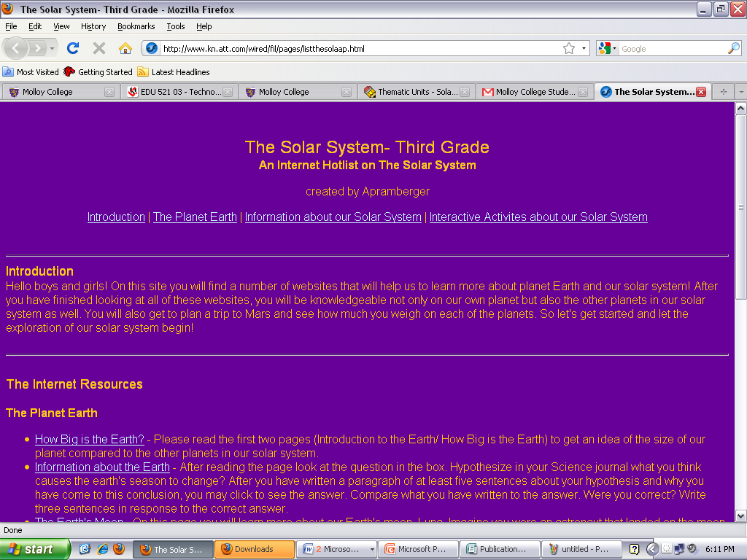
Filamentality Project

Slide 13
Lesson Plans
After watching a video from BrainPop.com followed by a podcast and discussion on the eight planets of our solar system, students will construct a mobile of the planets. The students must receive a 3 out of 4 on the rubric created for this assignment to have successfully met the objective.
SMART Notebook Activity, Brainpop video, podcast audio

Slide 14
Lesson Plans cont.
After a discussion on how weight is affected by the pull of gravity between two masses, students will calculate their weight using a website from an Internet Hotlist. They will enter this information into Create-A-Graph and create a bar graph scoring 3 out of 4 on a graphing rubric, then answer questions to demonstrate their ability to understand a bar graph with at least 80% accuracy.
Create-A-Graph website, DiscoveryEd.com video, IntelliKeys USB

Slide 15
My Final Project Presentation for the Class
http://thesolarsystemunit.weebly.com/

